Slide 1
Disclaimer
These slides are intended as presentation aids for the lecture. They contain information that would otherwise be to difficult or time-consuming to reproduce on the board. But they are incomplete, not self-explanatory, and are not always used in the order they appear in this presentation. As a result, these slides should not be used as a script for this course. I recommend you take notes during class, maybe on the slides themselves. It has been shown that taking notes improves learning success.

Slide 2
Reading for this set of slides
None
Please note that this set of slides is intended as support for the lecture, not as a
stand-alone script. If you want to study for this course, please use these slides
in conjunction with the indicated chapters in the text books. The textbooks are
available online or in the TUB library (many copies that can be checked out for the entire semester. There are also some aspects of the lectures that will not be
covered in the text books but can still be part of the homework or exam. For those
It is important that you attend class or ask somebody about what was covered in class.

Slide 3
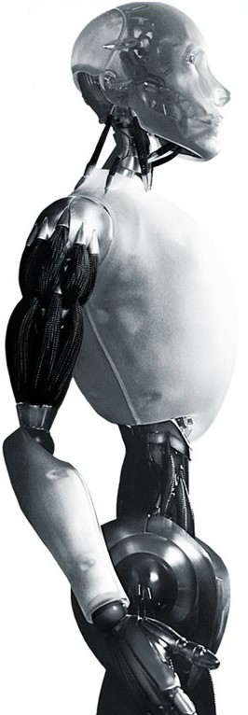
Robotics Quaternions
TU Berlin
Oliver Brock
TexPoint fonts used in EMF.
Read the TexPoint manual before you delete this box.: AAAAAAAA

Slide 4
Problems with Rotation
Rotation matrices are used most often, but
numerical error buildup
interpolation
complexity of multiplication
Angle representations address
numerical error buildup
Arbitrary axis representation introduces
zero rotation problem

Slide 5
Quaternions
Address:
numerical error buildup
interpolation
complexity of multiplication (among themselves)
But:
eliminate homogeneity
are inefficient when many points are rotated (then we convert them into a matrix before performing the rotation)

Slide 6
Problems with Rotation
Rotation matrices are used most often, but
numerical error buildup
interpolation
complexity of multiplication
Angle representations
address numerical error buildup
but have degeneracies (Gimbal problem)
Arbitrary axis representation introduces
zero rotation problem
Notes:
Image from: http://en.wikipedia.org/wiki/Gimbal_lock
Gimbal lock on Apollo 11
A well-known gimbal lock incident happened in the Apollo 11 Moon mission. On this spacecraft, a set of gimbals was used on an inertial measurement unit (IMU). The engineers were aware of the gimbal lock problem but had declined to use a fourth gimbal.^{[5]} Some of the reasoning behind this decision is apparent from the following quote:
"The advantages of the redundant gimbal seem to be outweighed by the equipment simplicity, size advantages, and corresponding implied reliability of the direct three degree of freedom unit."
—David Hoag, Apollo Lunar Surface Journal
They preferred an alternate solution using an indicator that would be triggered when near to 85 degrees pitch.
"Near that point, in a closed stabilization loop, the torque motors could theoretically be commanded to flip the gimbal 180 degrees instantaneously. Instead, in the LM, the computer flashed a 'gimbal lock' warning at 70 degrees and froze the IMU at 85 degrees"
—Paul Fjeld, Apollo Lunar Surface Journal
Rather than try to drive the gimbals faster than they could go, the system simply gave up and froze the platform. From this point, the spacecraft would have to be manually moved away from the gimbal lock position, and the platform would have to be manually realigned using the stars as a reference.^{[6]}
After the Lunar Module had landed, Mike Collins aboard the Command Module joked "How about sending me a fourth gimbal for Christmas?"

Slide 7
Quaternions
Address:
numerical error buildup
interpolation
complexity of multiplication (among themselves)
But:
eliminate homogeneity
are inefficient when many points are rotated (then we convert them into a matrix before performing the rotation)

Slide 8
But then what are Quaternions?
1844, Sir William Rowan Hamilton
Scratched into stone of Brougham bridge
Can be used as rotation representations
“Four-dimensional complex numbers”
Sometimes called Euler parameters
Notes:
http://en.wikipedia.org/wiki/Quaternions_and_spatial_rotation

Slide 9
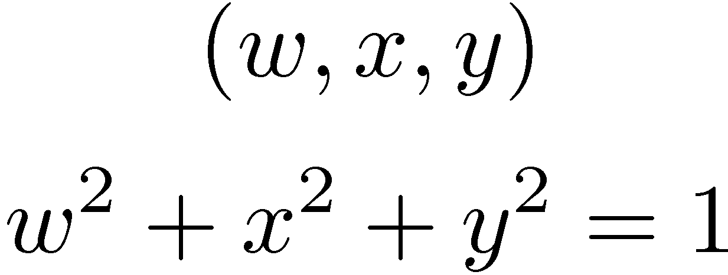
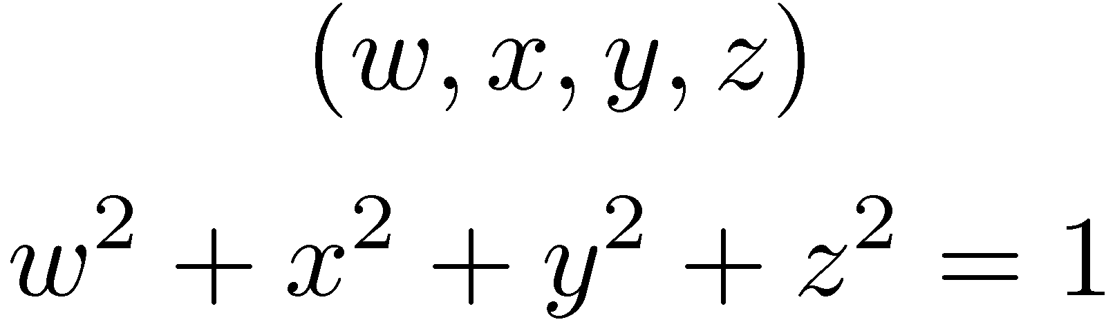
Parameterizing Rotations
Notes:
http://en.wikipedia.org/wiki/Quaternions_and_spatial_rotation

Slide 10
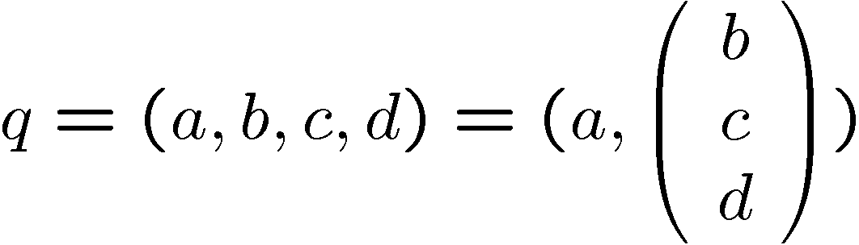
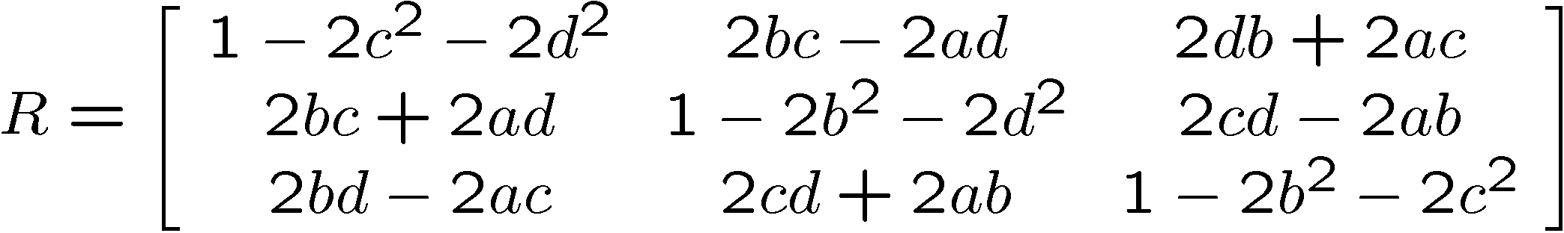
Unit Quaternion to Rotation Matrix

Slide 11



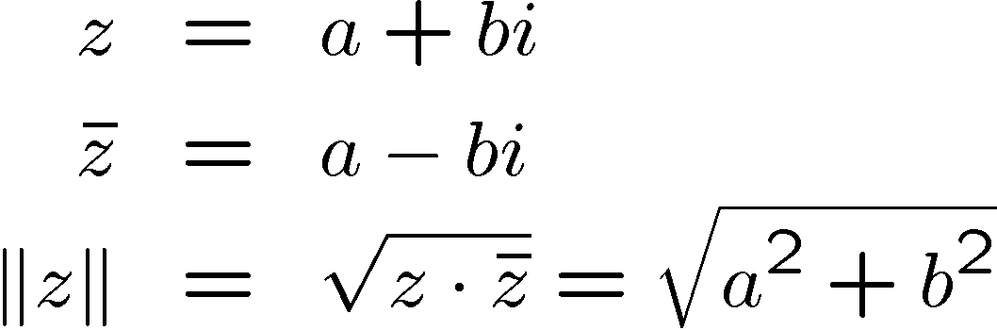

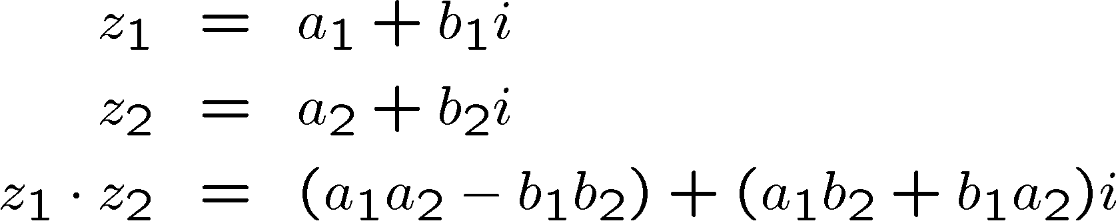
Complex Numbers

Slide 12
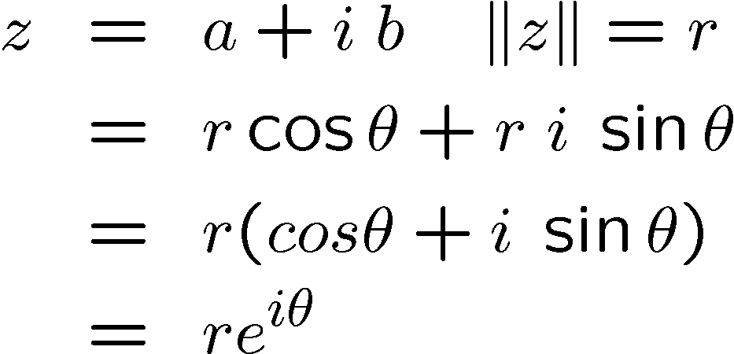


Sidebar I on Complex Numbers
b
r
a
Euler's Identity

Slide 13






Sidebar II on Complex Numbers

Slide 14
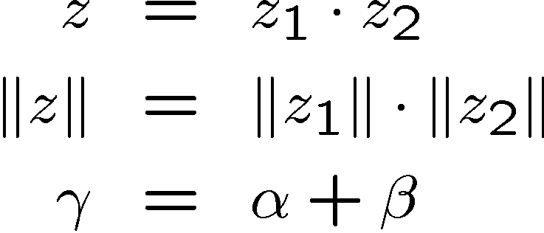






Sidebar III on Complex Numbers
unit circle
α, β, γ are called the argument of z₁, z₂, and z, respectively
α = arg(z₁), β = arg(z₂), γ = arg(z)

Slide 15


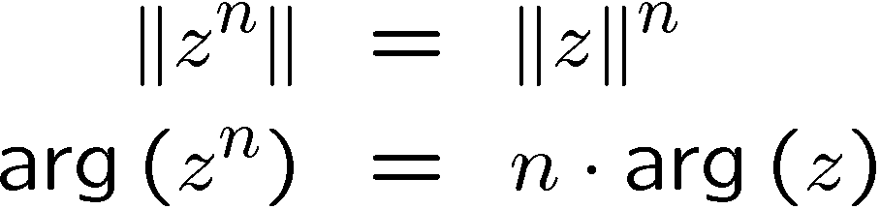



Sidebar IV on Complex Numbers
unit circle
geometric or exponential spiral

Slide 16
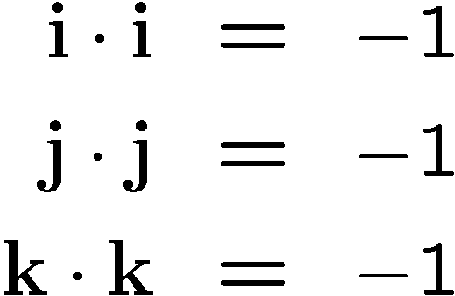
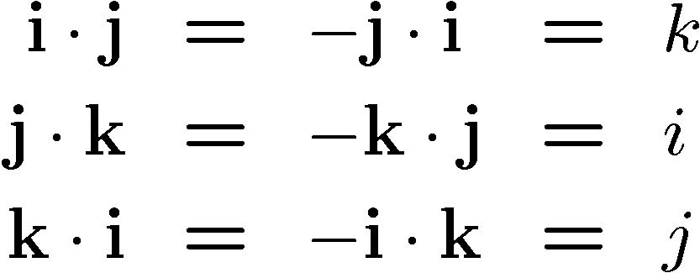
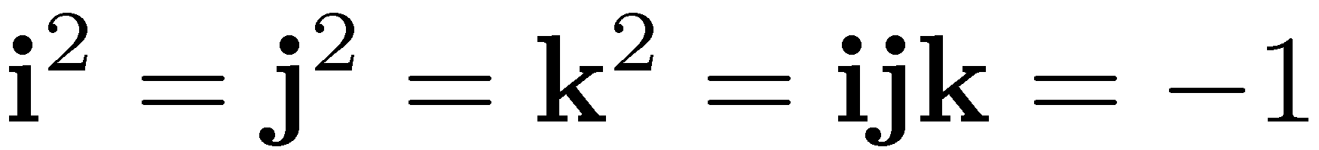
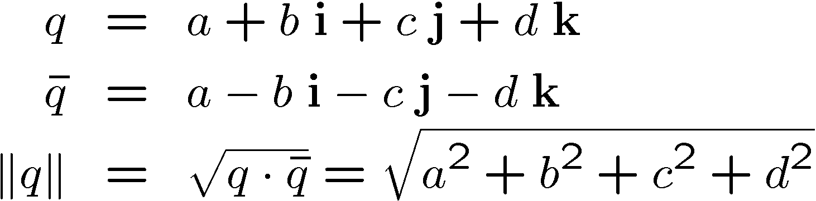
Quaternions
Quaternions are associative but not commutative!

Slide 17
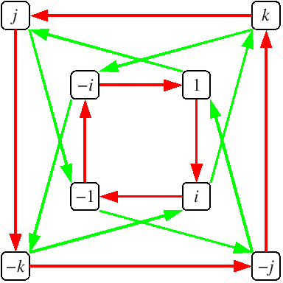
Cayley Graph
multiplication on the right by i
multiplication on the right by j
Notes:
Graph from http://en.wikipedia.org/wiki/Quaternion

Slide 18
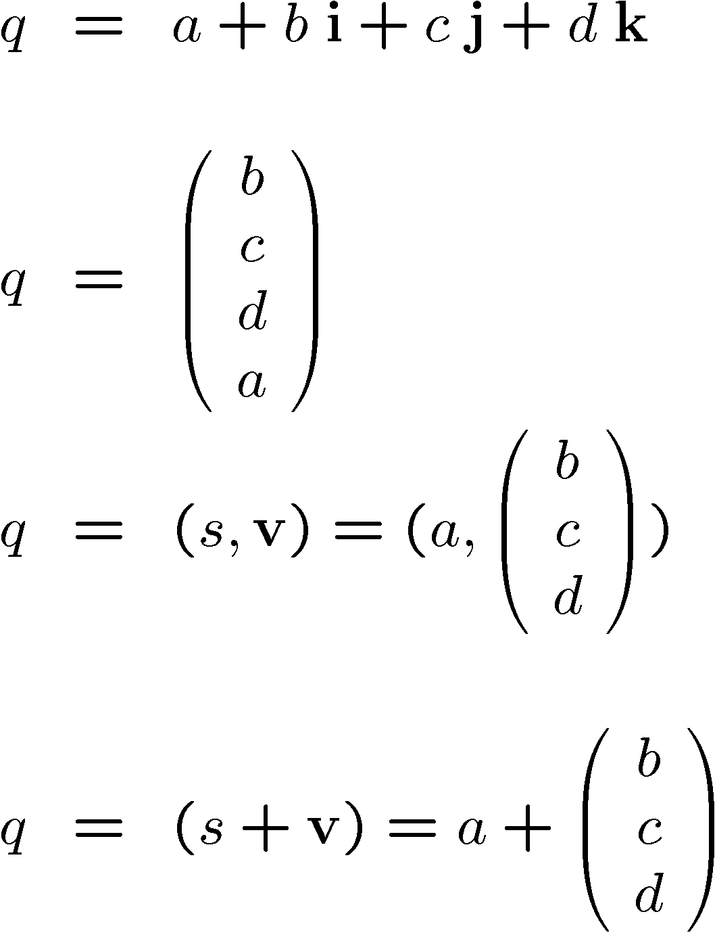
Representation of Quaternions

Slide 19

Quaternion to Rotation Matrix
The opposite direction is slightly more complicated, see
Wikipedia page on quaternions as spatial rotations
Notes:
From: http://en.wikipedia.org/wiki/Quaternions_and_spatial_rotation

Slide 20
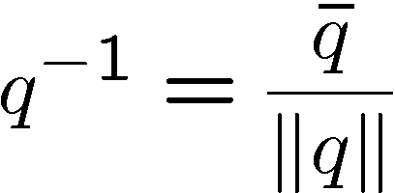
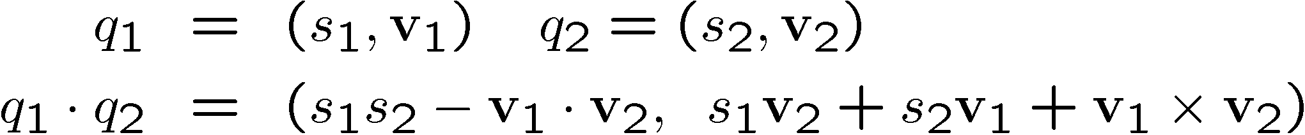
Operations on Quaternions
Inversion
Multiplication

Slide 21
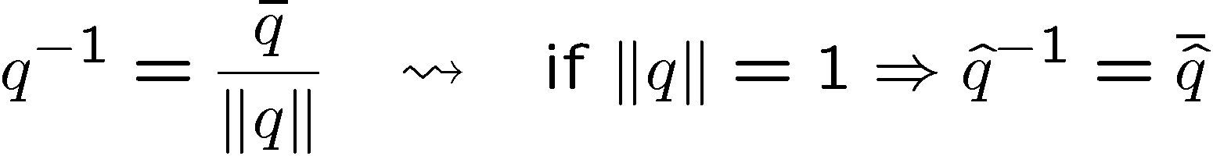
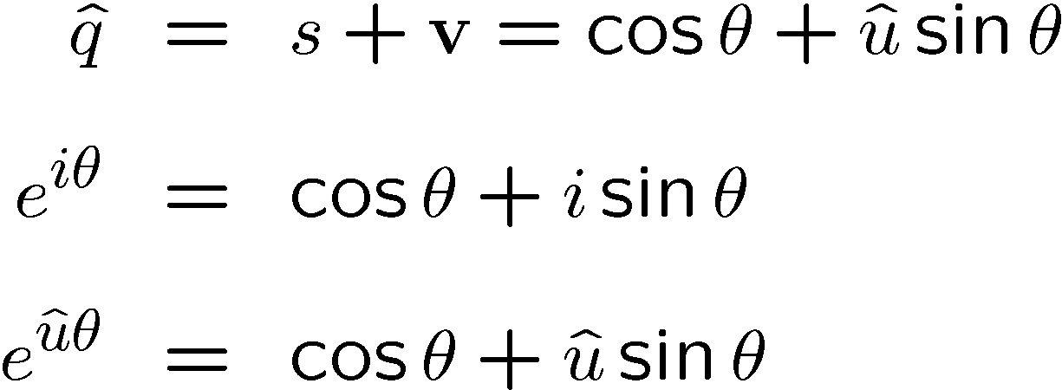
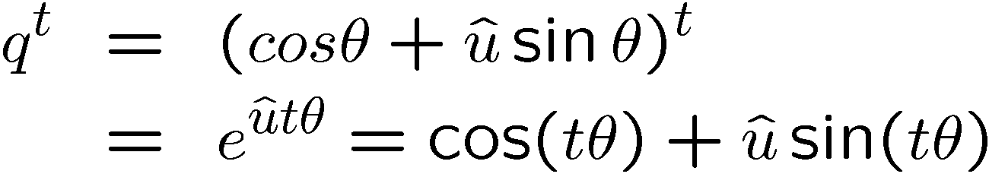
Operations on Unit Quaternions
Inversion
Exponential
Euler’s Identity
Exponentiation
Logarithm

Slide 22
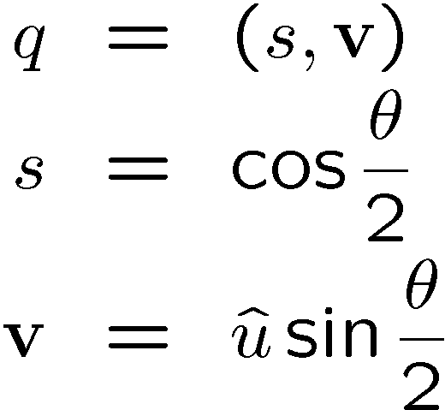
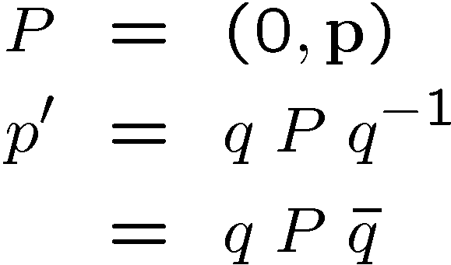
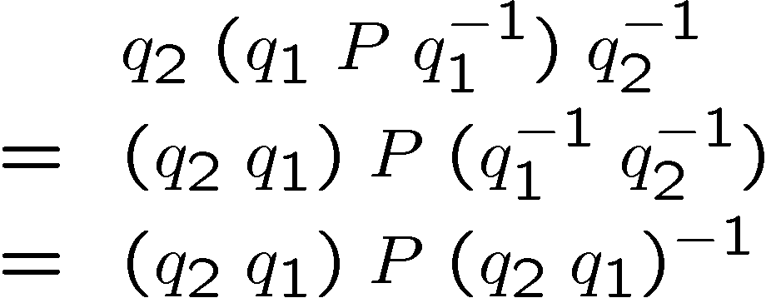
Finally! Unit Quaternions as Rotations
q representing a rotation by angle θ about axis û
rotating p using quaternion q
performing multiple rotations

Slide 23

Why are Quaternions Rotations?
Remember?
This is almost the same as it was
with the complex numbers!
Unit complex number means no
length change! This is slightly
different with quaternions:
unit circle

Slide 24
Quaternions as Rotations
Efficient inversion
Efficient concatenation
Efficient consistency check (normalize q)
What about interpolation?

Slide 25
Interpolation of Unit Quaternions
Interpolate between rotations represented by a and b:
Exponentiation is easy and efficient

Slide 26
Why Quaternions?
Often ignored
Powerful tool for some types of problems
Interpolation
Numerical stability
Efficiency
We will stick to homogeneous transforms

Slide 27
Summary
Frames
Homogeneous Transforms
Rotations
Matrix
Fixed angles
Euler angles
Arbitrary axis
Quaternions

Slide 28

Notes:
Illustrate what happens when a 2DOF rotational robot arm loses 1 DOF
Background image
https://www.pexels.com/photo/background-black-blackboard-board-159770/

